Slide 1
Capstone Project
Emerging Market Bonds:
Predicting the Price of Development
By Ken Colangelo
Cohort 12 NYCDSA

Slide 2
Personal Background
Asset Management: Fixed Income
Emerging Market Sovereign Analyst
Region Specialty: Frontier
2007-08 Recession led to US Fed Reserve cutting policy rate to 0%
Allowed markets to borrow in USD-denominated debt for the first time
Pros and Cons to borrow in a foreign currency
Deciding on where and at what price to invest our portfolio

Slide 3
Capstone Project
Many countries since then have issued bonds and new countries are still making maiden issues
A country approaches a bank to borrow money (a public bond)
The bank in coordination with the country meets with investors
Decides what terms to offer the bond to investors
Decides on tenor (i.e. 10 years), coupon, and price (usually at 100 or par)
Investors decide whether to invest in the primary market (at issuance)
The bond then begins to trade in the secondary market and the prices start moving up and down
An investor makes money from the interest from the (1) coupon and (2) price move of the bond
An investor wants to determine what the fair value of the bond is, buy when its cheap sell when expensive
Goal of Capstone: Using Machine Learning techniques predict valuations for potential new issues

Slide 4
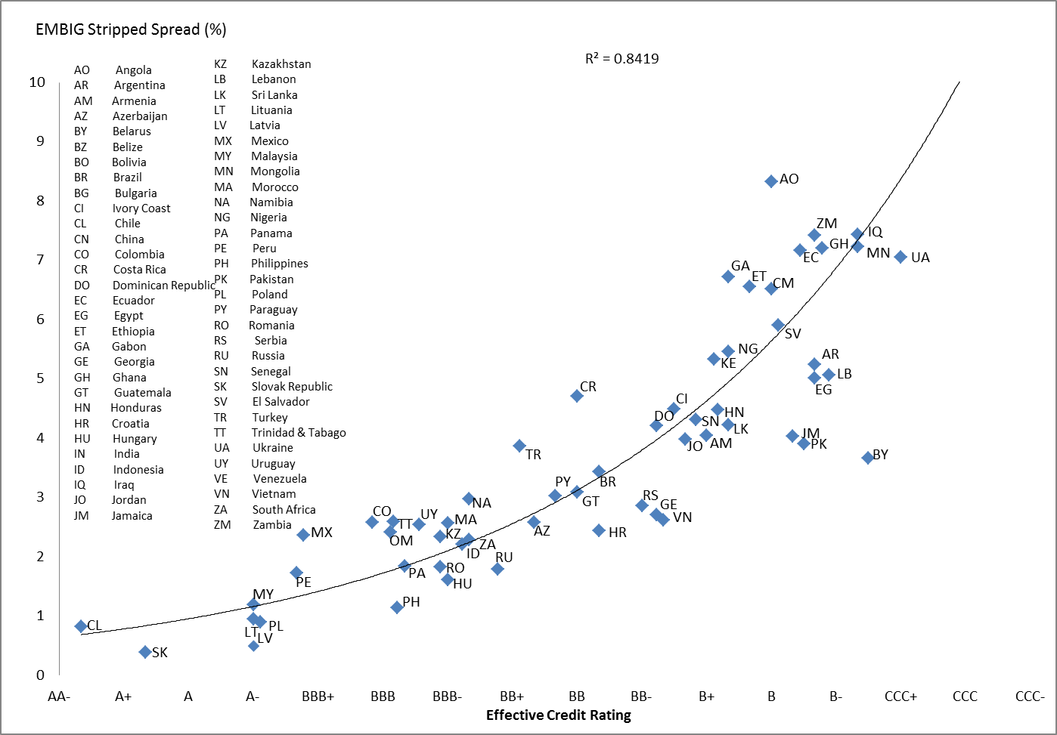
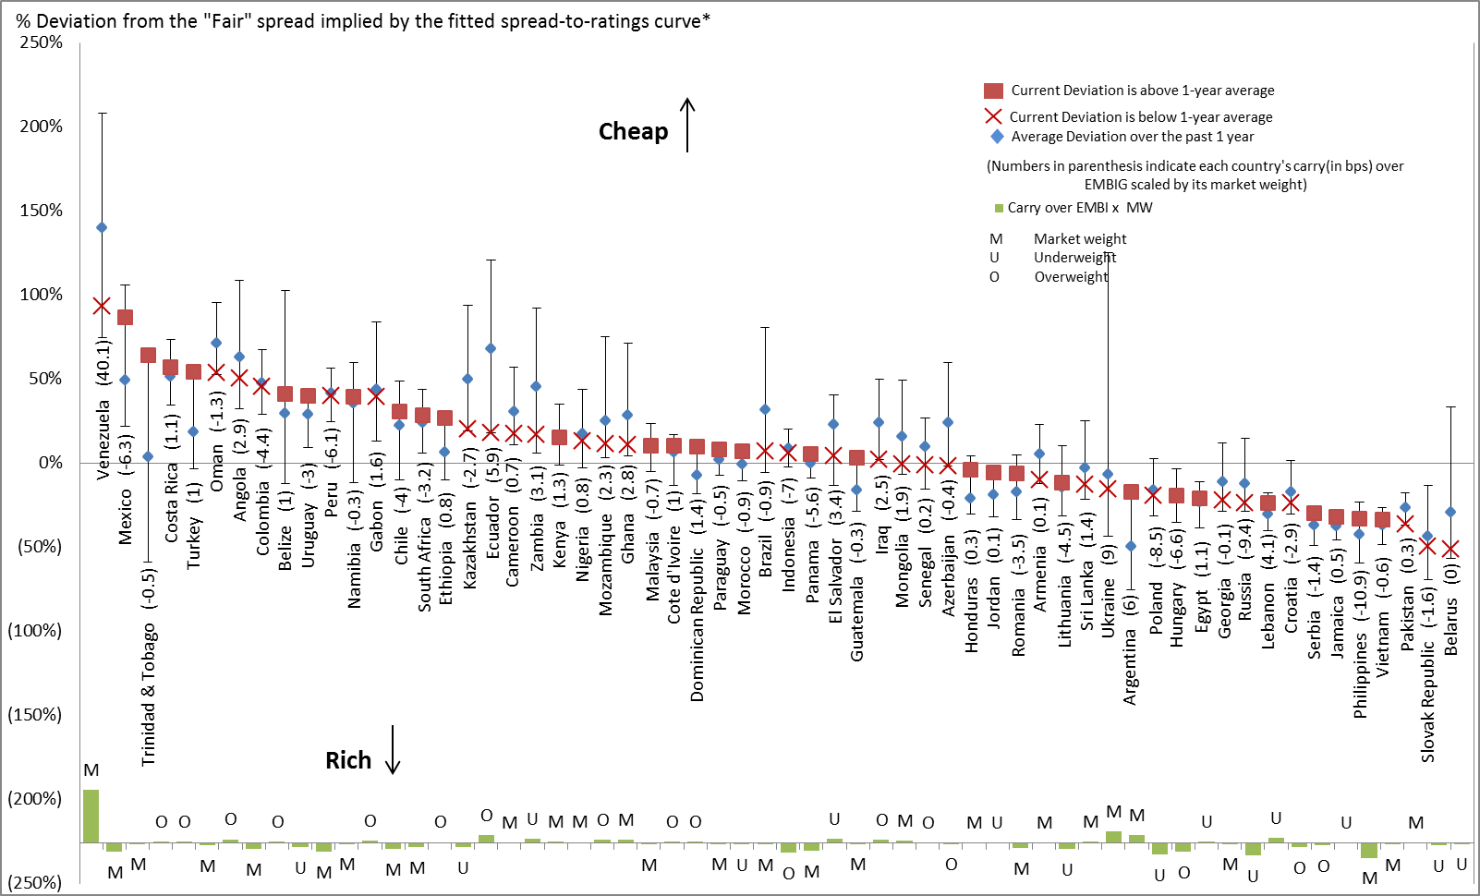
Outsourcing to Rating Agencies

Slide 5
Drawbacks to Relying on Ratings
Ratings are anchored to a country’s wealth (GDP per Capita)
This is how a rating agency can rate rich countries and poor countries on the same scale
Countries with high debt, but rich populations are considered ‘safer’ and assigned higher ratings – This is why Japan can have the highest debt in the world and still be rated investment grade (BBB or greater)
Inherent bias against low income developing countries (LIDC)
There are more Investment Grade ratings than High Yield ratings
Most countries due to their income levels are simply bucketed as single – B
Regardless of the composition of their economy (commodity exporter, debt level, deficits, etc.)
Not all countries are rated

Slide 6
Collect the Data
Collected 751 Emerging Market USD-denominated Bonds
Target (Y) was their coupon, which is their initial yield assuming they are priced at par (100)
Estimators
Bond Characteristics (size, tenor)
Prevailing risk-free rate (Treasuries)
Country Characteristics (Debt/Deficit, Growth, Inflation, Wealth)
Development Surveys (Ease of Doing Business, World Development Index)

Slide 7
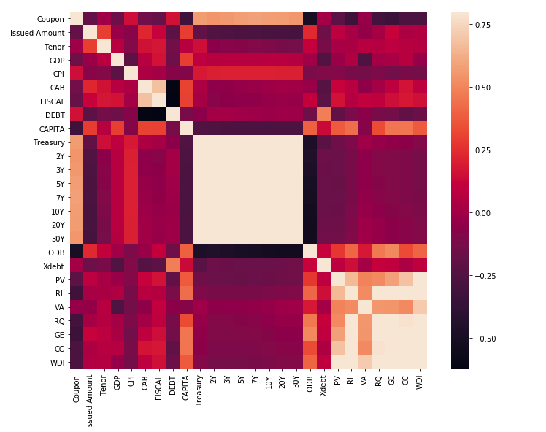
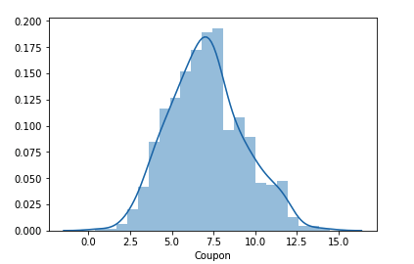
Exploratory Data Analysis
All the Treasuries are Correlated
As are the Governance Indicators
Solutions:
Use only same Treasury tenor
Perform clustering analysis to group Governance
Gaussian Target Distribution

Slide 8
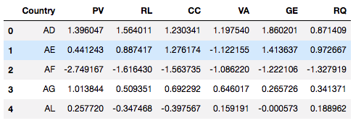
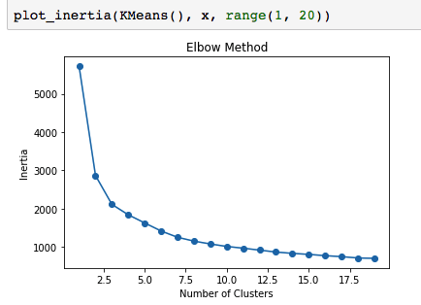
Clustering World Governance
All six indicators are related
Political Violence (PV)
Rule of Law (RL)
Corruption (CC)
Voice and Accountability (VA)
Gov Effectiveness (GE)
Regulatory Quality (RQ)
Chose 6 clusters based on the elbow method
Scatterplots show groupings
Clusters are then added to training and test sets then turned to a categorical value from numerical default

Slide 9
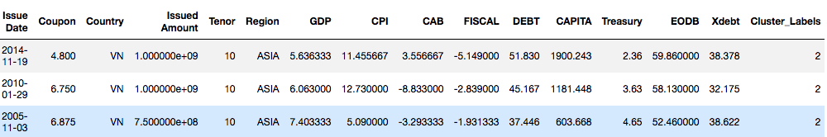
Linear Regression
After setting dummy variables (cluster_labels) and scaling our estimators we perform an elastic net and regularize our model
We then perform a grid search cross validation to find the best parameters
Do our coefficients make sense?
The higher the Treasury yield, the higher the yield of the bond
The higher the growth the lower the yield of the bond
The better the ease of doing business the lower the yield of the bond

Slide 10
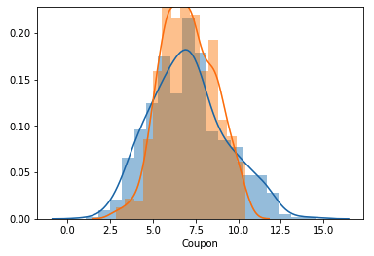
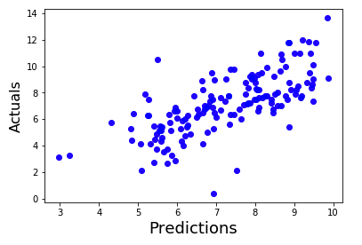
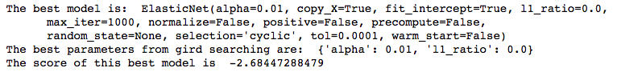
Linear Regression Predictions
The Linear Regression does not perform that well and explains only about 49% of the variance
However, intuitively the predictions make some sense
The higher the tenor the higher the yield
The more politically unstable the higher the yields
The worse the macroindicators the higher the yields
Provides yields for unrated securities

Slide 11
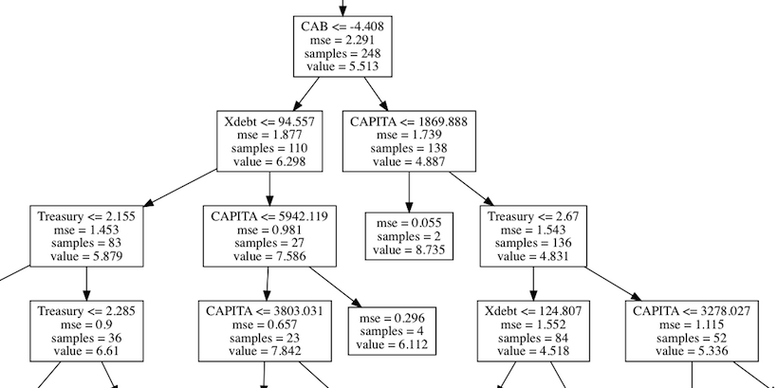
Decision Trees
Using recursive partioning the data does not to be scaled or dummy variables created
Variable Importance makes sense with Treasuries being the most often used to split the data
After performing gridsearch cross validation we have improved our accuracy to 52%, while fitting the model 82% representative on the training set
Variable Importance

Slide 12
Decision Tree Predictions
Though we can follow the path of a decision tree (pro)
Splits may not adequately explain the relationships
Here we can intuitively see that riskier countries have higher yields, but not all show changes with tenor
By producing only one tree – if the split isn’t made at all the desired points we won’t get the differentiation we want
A Random Forest would make more sense, so many trees are created with randomly picked splitters.

Slide 13
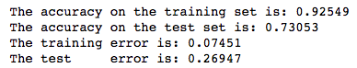
Random Forest Predictions
We lose the clarity of a single tree but now our model explains significantly more of the variation
Variable importance has stayed basically the same
Our predictions now make more sense with tenor affecting yield
Gridsearch would improve results, but takes significant time to process

Slide 14
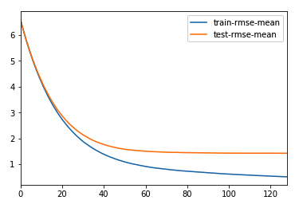
XGBoost
Instead of creating many trees and aggregating, we can focus on IMPROVEMENT and build trees focusing on the errors
Unlike random forest, categorical values need to be dummified
Issue Amount has made its first appearance as the most important feature
Optimal number of boost rounds is 129
Very low error with the difference between the actual and the predicted values only 0.007 or 0.7 bps

Slide 15
XGBoost Predictions
Both Tenor and Risk show intuitive relationship (positive sloping curve and riskier credits have higher yields
We are likely missing estimators to properly predict, i.e. Afghanistan is predicted to be able to issue a 10yr $1bn bond at 5.93%
However, given the estimators we used this does make some sense if we focus on the macroeconomic factors
Focusing on the estimators for Afghanistan:
Macroeconomic indicators are strong
Growth is 2.1%, Inflation is 3.2%,
C/A Surplus of 4.9%,
Fiscal Deficit of -0.3%, Debt of 7.6%
Ease of Doing Business is low
Weak cluster of World Development Indicator
Poor country with $572 per capita

Slide 16
Conclusions
Further work is needed to increase confidence in our estimates
Use of more frequent data (quarterly)
Increasing the number of bonds analyzed
Adding more variables
Speaking with other analysts
Machine Learning allows a greater amount of data to be analyzed in a fraction of the time – applied in various industries we will be able to shorten the time it will take to begin to add value to our organizations
Grid Search Cross Validation specifically is a Godsend to choosing the optimal parameters for our models
Enrolling in this bootcamp, while very challenging has certainly enhanced and expanded my analyst toolkit

Slide 17
Thanks and Questions
Thanks to Drace and Zeyu for allowing me to complete this independent study
Thanks to Sean for being the point TA for this capstone project and for reviewing each modeling technique from theory to code
Thanks to Aaron for being my course TA and go to person for venting
Questions???

